Slide 1
Medical Equipment Maintenance Challenges By Ethiopia COVID-19 Response Team (ECRT)

Slide 2
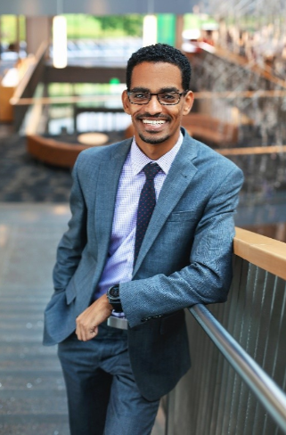
Yonathan Kebede MHA, FACHE Vice President of Operations Premier Health
Our Speaker Today

Slide 3

“We are all on different ships during this storm, experiencing a very different journey.”
— Unknown Author

Slide 4

ECRT
1,750+ Global Volunteers
About Us

Slide 5
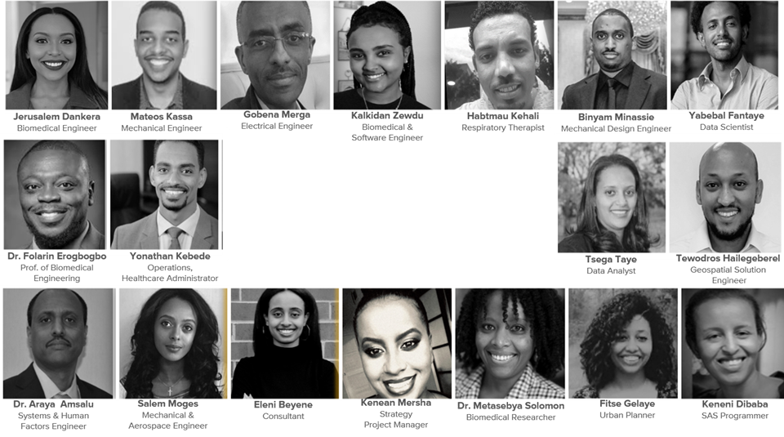
Meet Our Team
Notes:
Here are some of the team members - Biomedical, Mechanical, Electrical, Aerospace Engineers, Healthcare professionals, Project Managers, Consultants

Slide 6
What We Do
Local Medical Device Manufacturing
Protective Gear
Healthcare Workers Support
Medical Device Maintenance
Essential Items Delivery
Medical Devices Donations
Data Storytelling

Slide 7
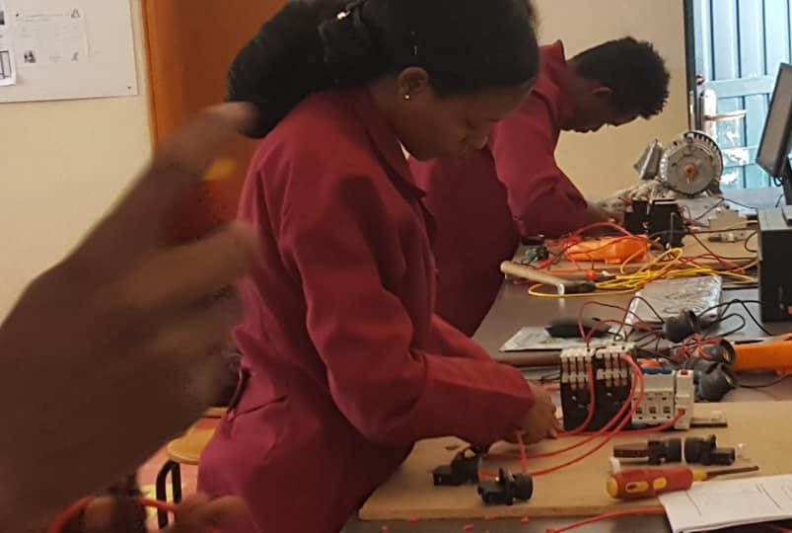
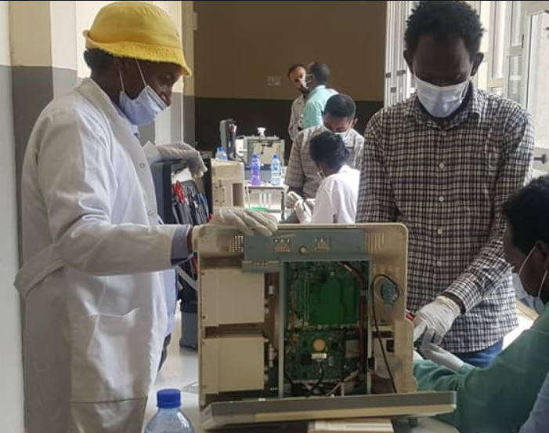
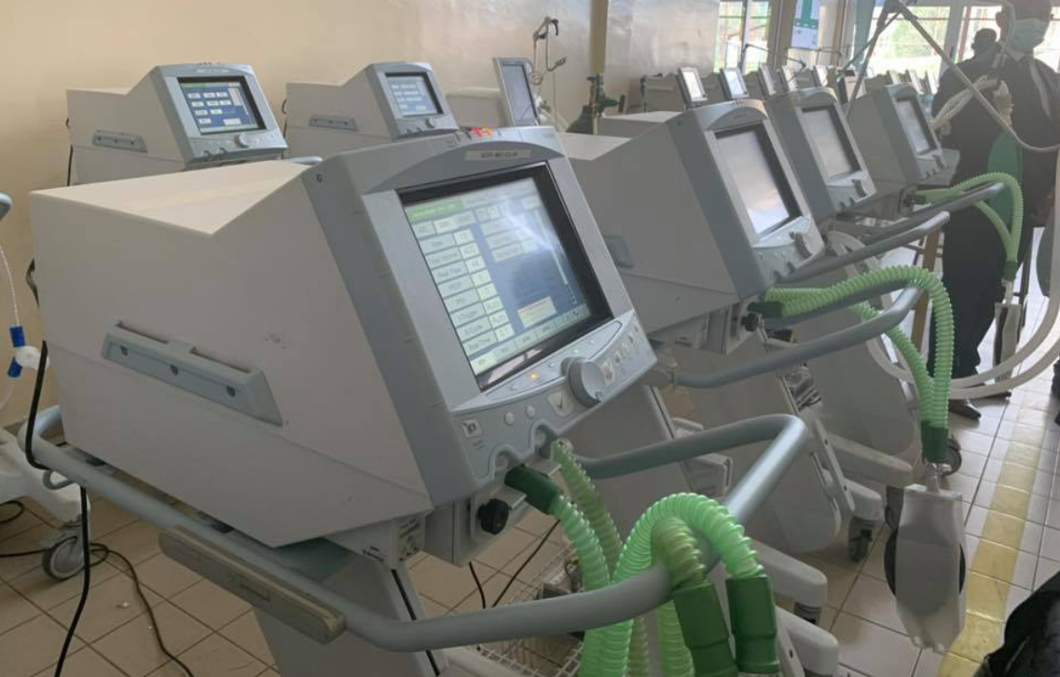
Tegbareid Polytechnic College

Slide 8
The Problem
40% - 70 % OF MEDICAL EQUIPMENT IN LOW/MIDDLE INCOME COUNTRIES ARE BROKEN, UNUSED OR UNFIT

Slide 9
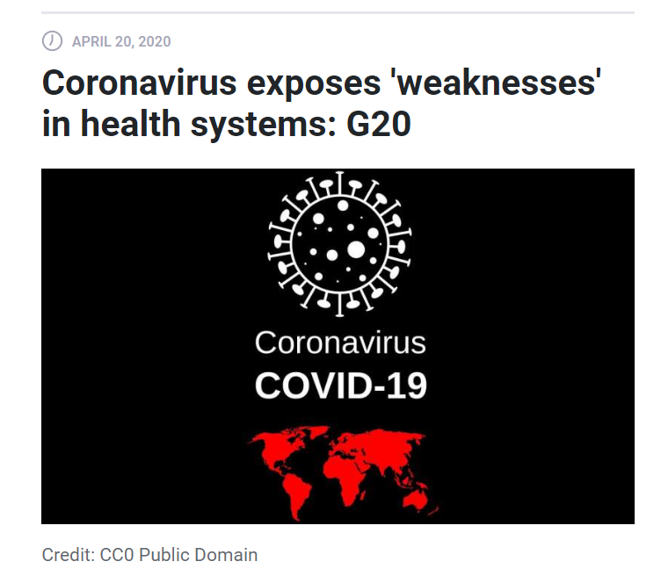
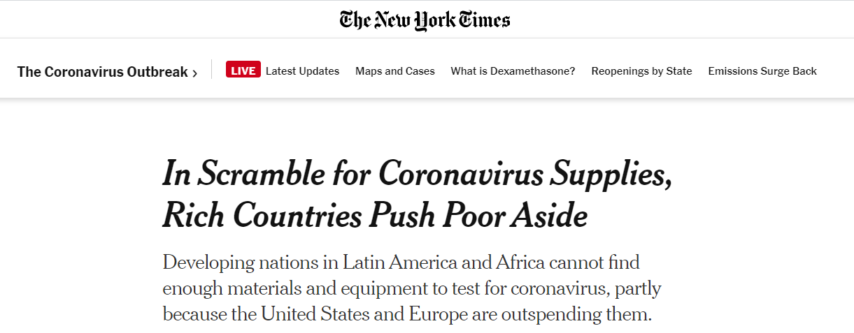

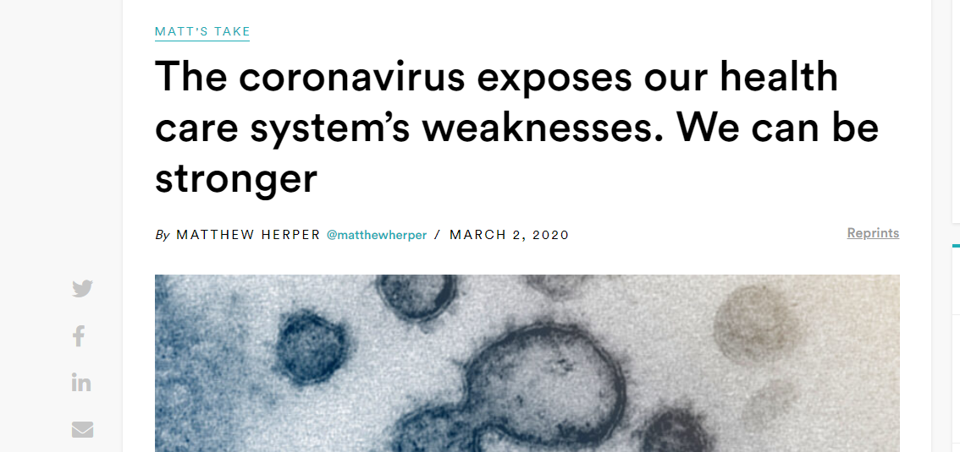

Slide 10
Contributors to this challenge
Lack of Asset Management
1
Lack of Training and Support
2
Mismatch
3

Slide 11
$93 billion

Slide 12
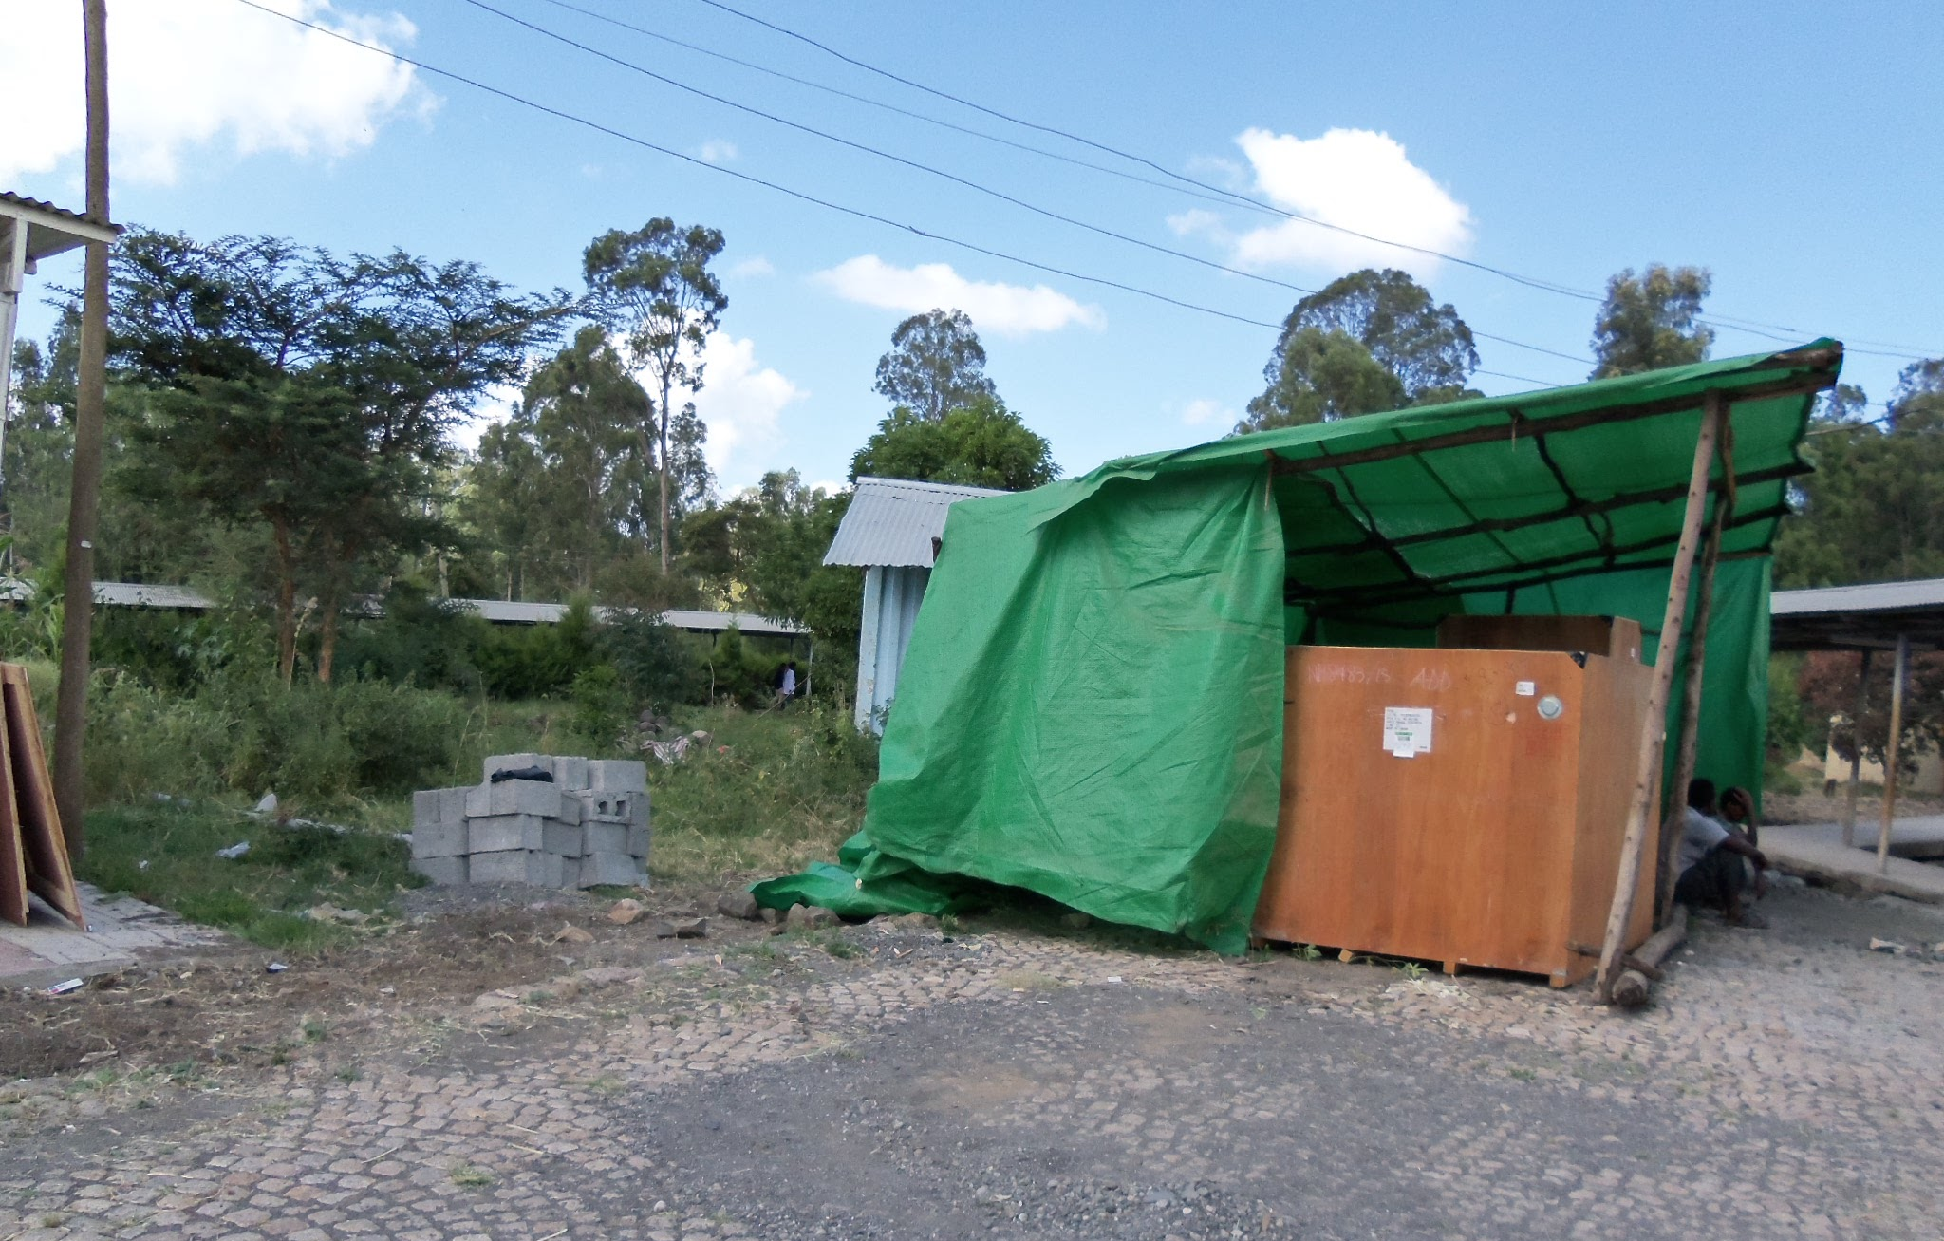
Medical equipment stored in the open
#1 - Lack of Asset Management

Slide 13
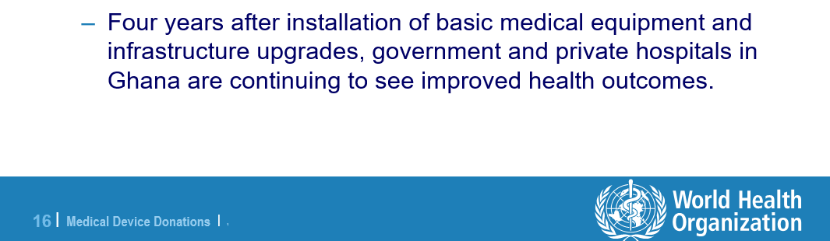
Ghana - A Case Study

Slide 14
#2 - Lack of Training & Support
"Many times the machines have just been phased out and are no longer supported by the company," Lloyd Jenkins - International Aid

Slide 15
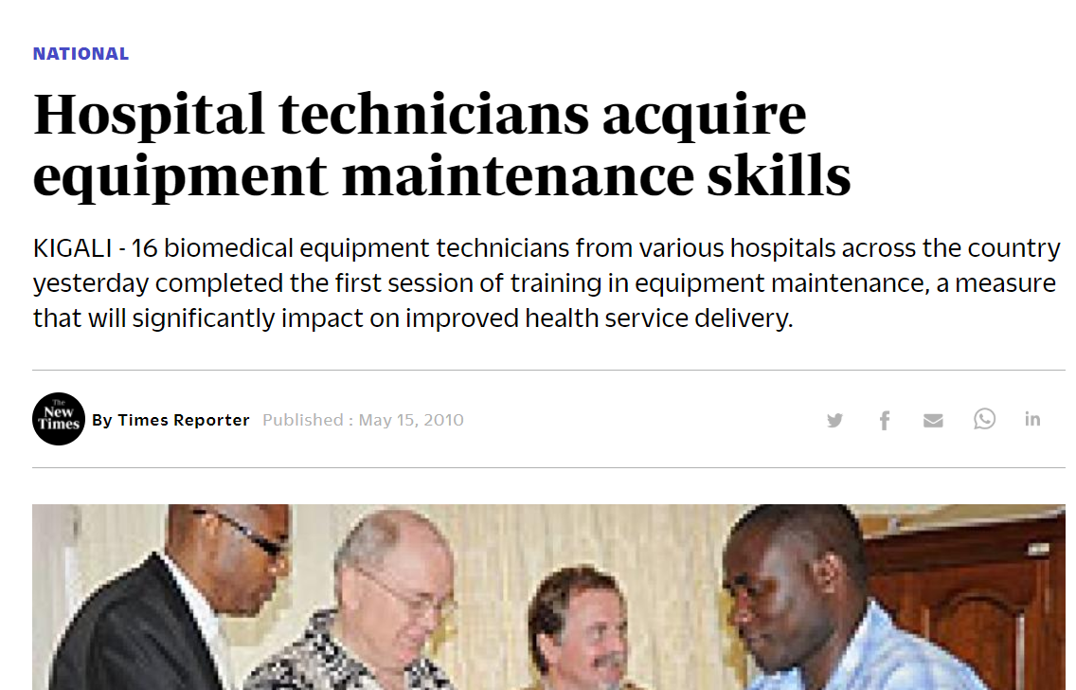
Rwanda: A Case Study
Number of out-of-service equipment fell by 50%

Slide 16
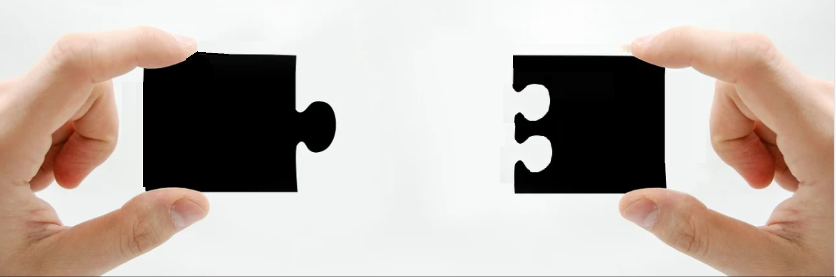
#3 - Mismatch

Slide 17
80 percent of the medical equipment in developing countries is donated. - World Health Organization
40% are Nonfunctional
Source - NPR.org

Slide 18
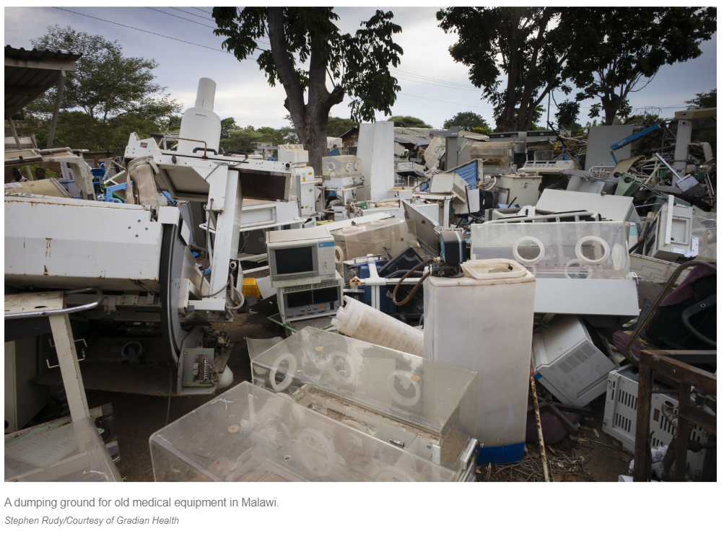
A dumping ground for old medical equipment in Malawi.

Slide 19
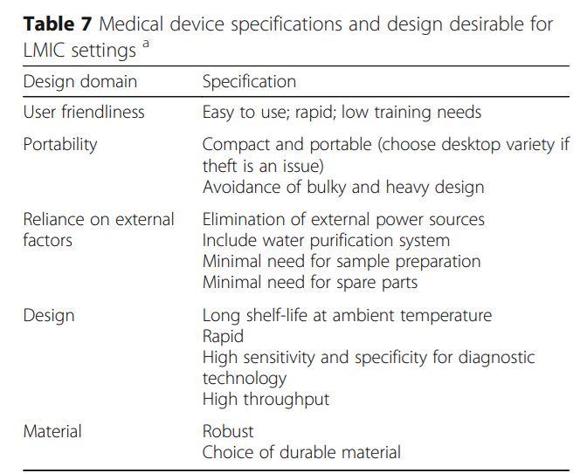

Slide 20
Thank You
Contact Us - info@ethiocovid19rt.com

